Slide 1
Predicting Wildfires

Slide 2
Info on our Dataset
Database: SQLite database
Time Range: 1992 to 2015
Importance: Crucial for Fire Program Analysis (FPA) system
Records: Over 1.88 million geo-referenced entries
Identification codes
Fire names
Date and time of fire discovery
Cause of the fire
Containment details
Geographical data (latitude and longitude)
Data Sources: Federal, state, and local fire organizations

Slide 3
Data Pre-Processing
Verification of Database Size:
Ensured completeness of downloaded database file.
Installation of Necessary Tools:
Geopandas for geographic data handling.
Pycountry for country data management.
Database Connection Establishment:
Utilized sqlite3 for primary database access and querying.
Database Integrity Check:
Confirmed successful loading and integrity of dataset through cursory examination of database tables.
Loading of External Datasets:
Utilized geopandas to load datasets like naturalearth_lowres for geographic data visualization.

Slide 4
Logistic Regression
The model we chose to use was a logistic regression model. The main benefits of this model
Simplicity: Logistic regression is straightforward to understand and implement. Its simplicity makes it easy for situations without extremely complex models
Efficiency: Logistic regression tends to require less computational resources compared to more complex models, making it computationally efficient. This makes it suitable for large datasets and real-time applications.
Scalability:Logistic regression can handle large datasets efficiently, making it scalable for big data applications. It performs well even with a large number of predictor variables.

Slide 5
Model Training
Training Dataset:
X_train_preprocessed: Preprocessed training dataset.
y_train_binary: Binary target variable.
'1' represents large fires.
'0' represents all other categories.
Model Implementation:
Utilized LogisticRegression from scikit-learn.
Increased max_iter parameter to ensure convergence.
Logistic Regression:
Applied logistic regression for binary classification.
Tasked with predicting the likelihood of large wildfires.

Slide 6
Model Validation
Validation Dataset:
X_test_preprocessed: 20% of dataset was used for validation and 80% for training.
Assessment Method:
We look at the scores for train vs test accuracy
Train Score: 74%
Test Score: 67%
Pretty close which is good

Slide 7
Performance Evaluation
Evaluation Metrics:
Accuracy: Measures overall correctness of the model.
Precision and Recall: Assess model's performance for positive class, addressing false positives and false negatives.
Precision: 65%
Recall: 67%
F1 Score: 0.646579

Slide 8
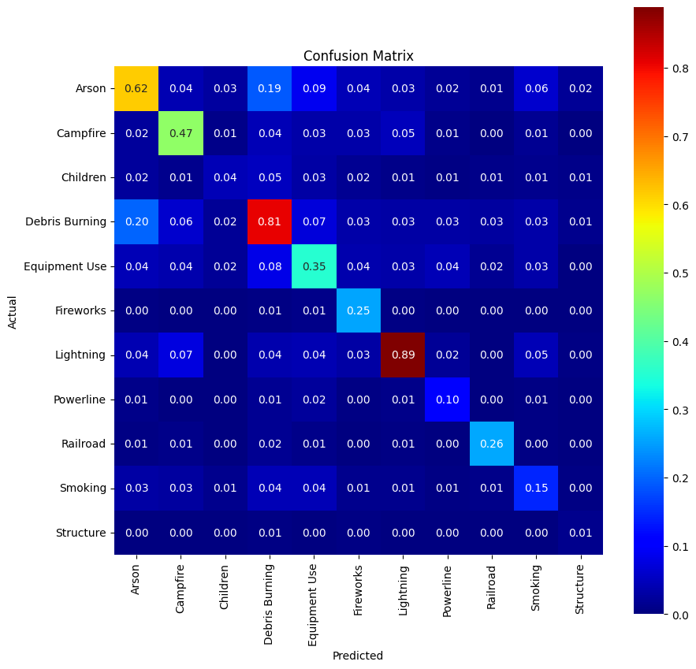
Confusion matrix
High score for lightening and debris as leading cause for fire as expected
Arson and camp fire show moderately high correlation as well
There is some weak correlation for railroad and fireworks as well

Slide 9
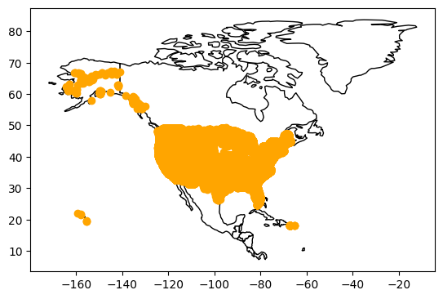
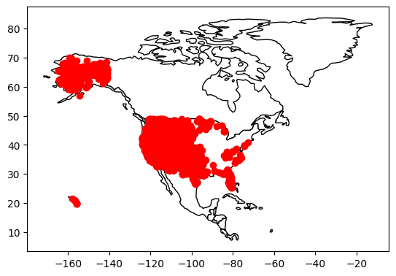
Visualization of data
All fires (yellow) versus more than 5K acres (in red) in USA

Slide 10
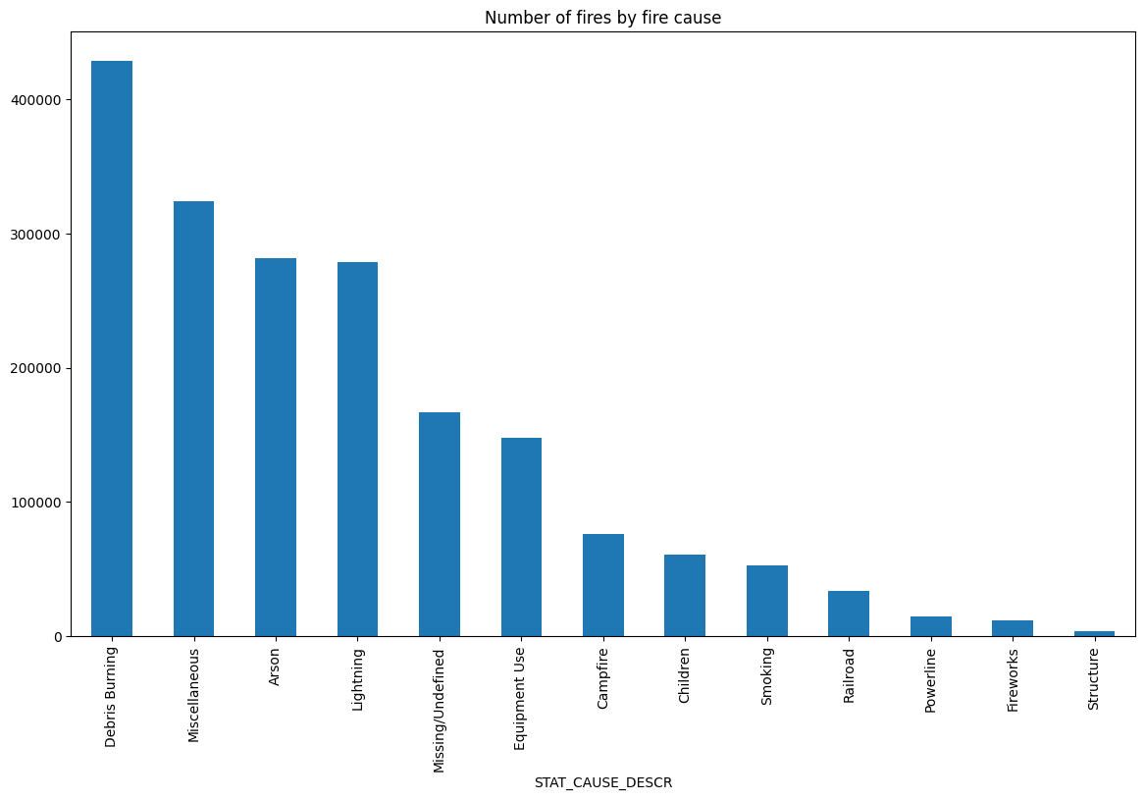
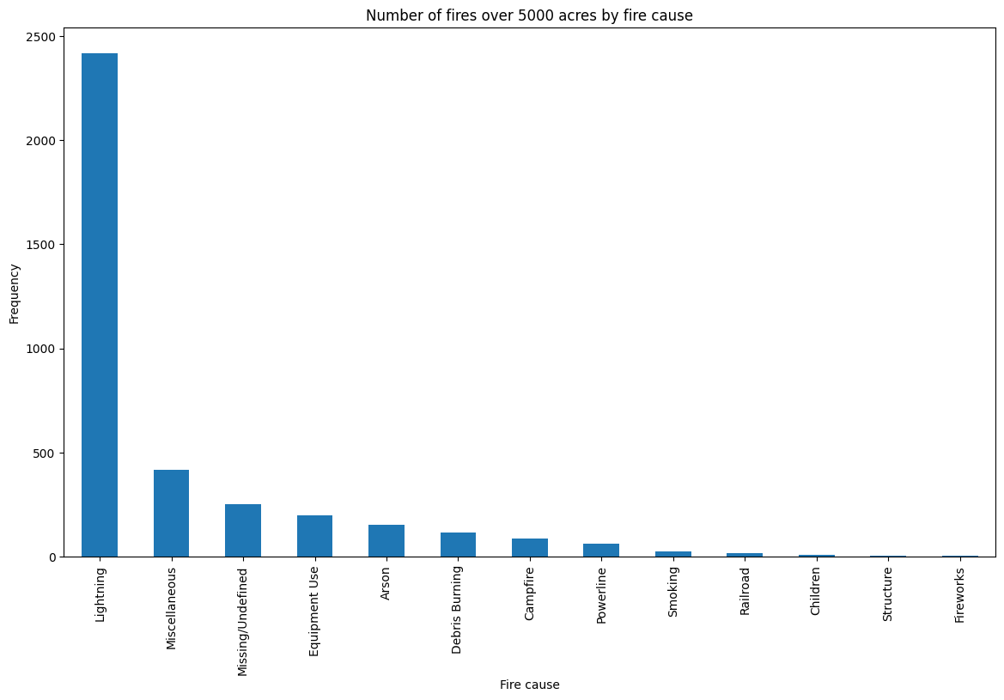
Visualization of data
Histogram: Leading cause of fires for all fires versus more than 5K acres

Slide 11
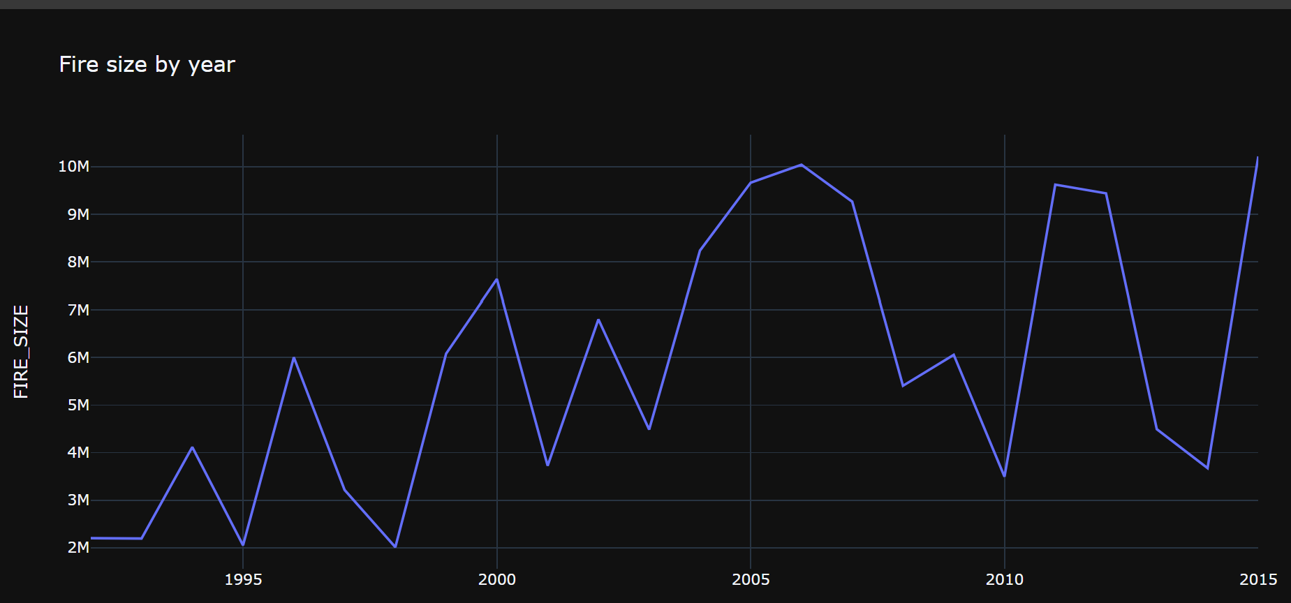
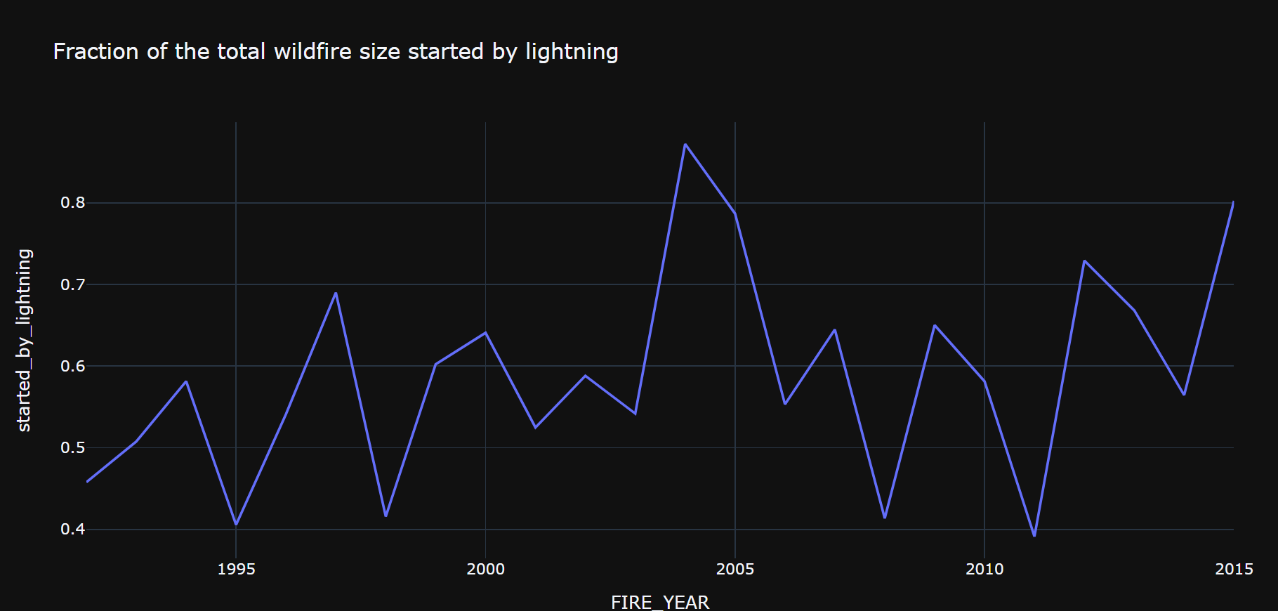
Visualization of data
Line graph: all fires by year versus fires started by lightening by years

Slide 12
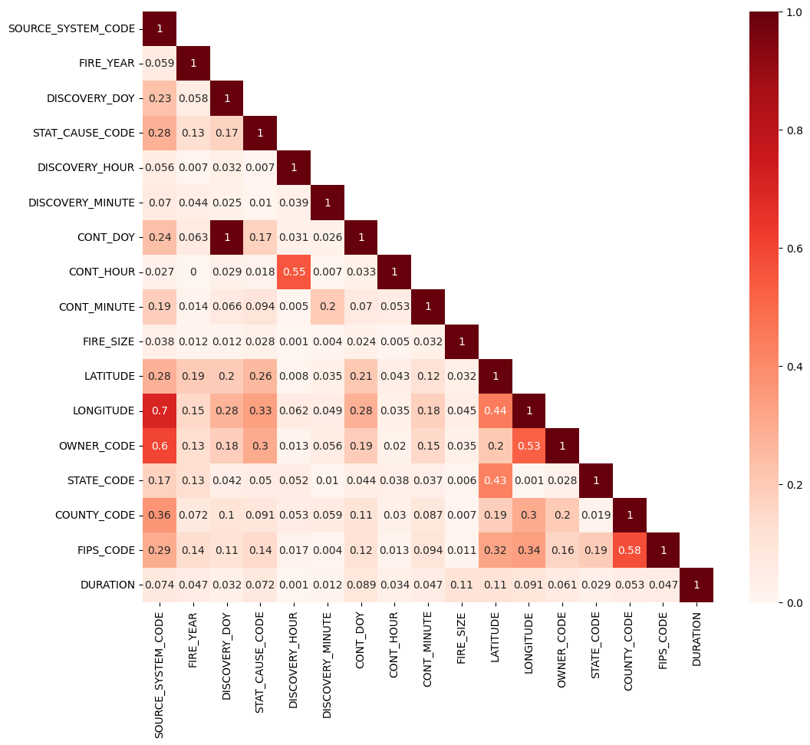
Visualization of data
Correlation plot shows some of the highly correlated features.
Some of the most correlated features are the location and time

Slide 13
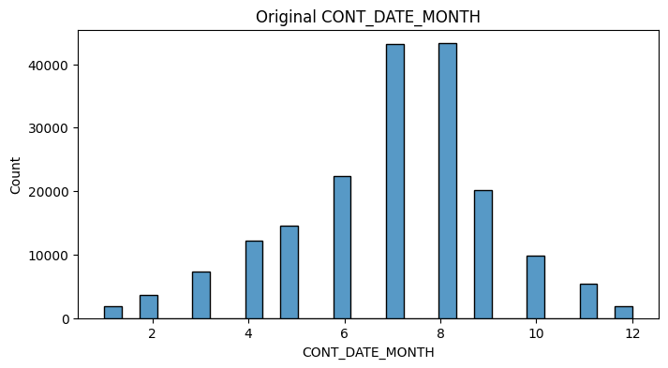
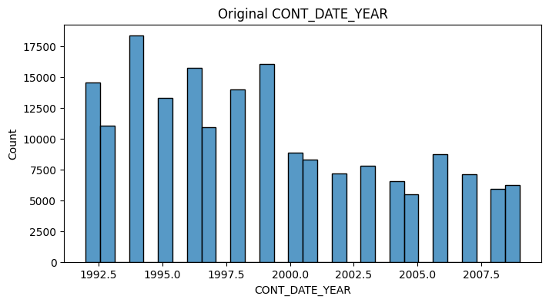
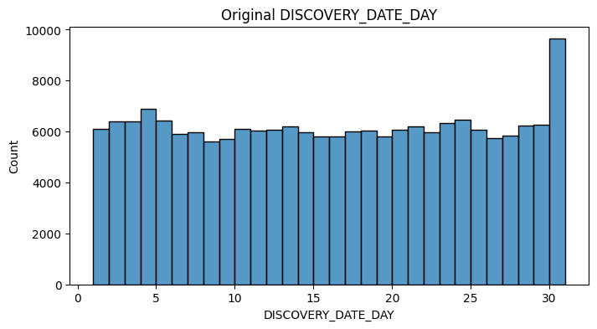
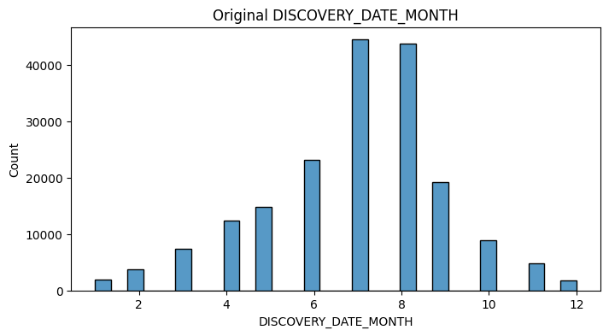
Insert Imagine of Visualization
https://colab.research.google.com/drive/1n7JAbTtVNvM3nhg63SAPtHeZN1fxUreh?usp=sharing#scrollTo=l8p0dlHkLbGA see more here

Slide 14
Conclusion
We created a foundational logistic regression model that predicts large wildfire risks using historical and environmental data.
The model's interpretability and detailed risk assessments are valuable for wildfire management.
Future improvements may include exploring more complex models and integrating real-time weather data for enhanced prediction accuracy.

